Slide 1

MCA Major Project
Resume Builder
Under the guidance of
Dr. Monika Jyotiyana
Department of Computer Applications
Faculty of Science, Technology and Architecture
Manipal University Jaipur
By
Divyanshu Singhal
23FS20MCA00072
2023-25

Slide 2
Outline
Introduction
Motivation
Process Model
Software Requirement Specification (SRS)
Data Flow Diagram (DFD)
Conclusion
Future Scope

Slide 3
INTRODUCTION
In today’s job market, having a good resume is really important. But making a professional resume can take a lot of time and effort. To make this easier, I built a Resume Builder application as part of my major project during my internship.
This tool helps students quickly create clean and professional resumes. It also includes an ATS (Applicant Tracking System) checker that shows how well a resume will perform when scanned by hiring software used by many companies.
The application is designed to be simple and user-friendly, allowing users to fill in their details step-by-step without needing any prior design skills. It offers pre-defined templates and formatting options to make the final resume look polished and industry-ready.
Additionally, the ATS checker uses AI to analyze keywords, formatting, and overall relevance to the job title entered by the user. This feature helps students understand how to improve their resumes to increase their chances of getting noticed by recruiters and automated hiring tools.

Slide 4
MOTIVATION
The idea for this project came from the need to make resume building easier for students at the college level. Many students face challenges with formatting and organizing their resumes properly.
Supporting students in job preparation: Many students find it difficult to format and structure their resumes correctly. This platform helps them create professional resumes with guidance tailored to their needs.
ATS Score Checker: The platform includes an ATS (Applicant Tracking System) score feature that helps students see how well their resume is likely to perform when scanned by hiring software used by many companies.
Learning and innovation: This project has allowed me to explore enterprise-level SaaS development, integrating Next.js, Node.js, MongoDB, authentication systems, and scalable architecture.

Slide 5
PROCESS MODEL
AGILE DEVELOPMENT
Why Agile?
The Agile model was chosen for this project because it offered flexibility, faster iteration, and better project tracking-ideal for a solo/student-led development process. Since the Resume Builder involved multiple evolving features like AI-based suggestions to improve format and ATS scoring, Agile allowed the work to be broken down into small, manageable sprints, each delivering a working component (e.g., login, form sections, PDF export). This approach made it easy to adapt to changes, incorporate feedback early, and improve UI/UX continuously. Agile also helped in maintaining consistent progress through weekly planning, without overwhelming the development process with rigid structures.

Slide 6
Requirement Gathering (Sprint 0):
Initial planning session to define the project scope: Resume Builder with ATS and AI assistance.
Identified user stories like: "As a user, I want to create a resume with live preview", "As a user, I want AI to suggest ATS based changes", "As a user, I want to upload my resume and get ATS score".
2. Sprint-Based Development:
The project was divided into short sprints (1-2 weeks each), with each sprint targeting a specific module or feature:
Sprint 1 – User Authentication (Clerk), Project setup.
Sprint 2 – Multi-step Form (React Hook Form + Zod).
Sprint 3 – Live Resume Preview & Auto Save.
Sprint 4 – AI Suggestions based on ATS using Gemini 2.
Sprint 5 – ATS Resume Upload and Scoring.
Sprint 6 – PDF Export and Final UI polish.

Slide 7
3. Daily/Weekly Standups:
Regular review sessions (could be weekly if solo or small team) to check progress, update the task board, and adjust priorities.
Continuous Testing & Feedback:
After each sprint, the feature was tested manually or with unit tests.
User feedback was collected early (friends, peers), and changes were made based on real feedback.
Final Sprint (Sprint 7):
Bug fixes, performance tuning, and documentation.
Prepared the project for submission/demo.

Slide 8
SOFTWARE REQUIREMENT SPECIFICATION
Project Title: Resume Builder
Objective: To build a smart, user-friendly resume builder that generates ATS-friendly resumes with real-time preview, AI-powered suggestions based on ATS, and resume scoring based on job relevance.
Scope: A web application for creating, editing, previewing, and downloading resumes with intelligent features like ATS compatibility analysis.
Functional Requirements:
Secure user authentication using Clerk
Multi-step form with autosave to MongoDB
Live resume preview panel
Download as ATS-friendly PDF
Upload resume for ATS score, suggestions, and strength detection using Gemini AI 2

Slide 9
Non-Functional Requirements:
Responsive design (mobile & desktop)
Fast load times & autosave (under 2s)
Secure communication over HTTPS
Modular and maintainable code structure
Technology Stack:
Frontend: Next.js, TypeScript, Tailwind CSS, Shadcn UI
Backend: Node.js, Express.js
Database: MongoDB
Authentication: Clerk
AI Integration: Gemini 2 API
Resume Parsing: pdf-parse

Slide 10
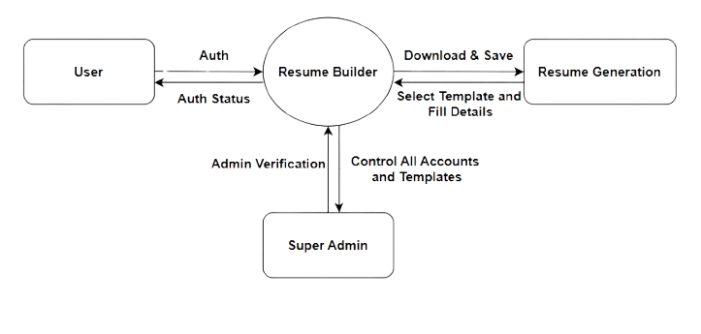
DATA FLOW DIAGRAM
Figure 5.1 Context Level DFD

Slide 11
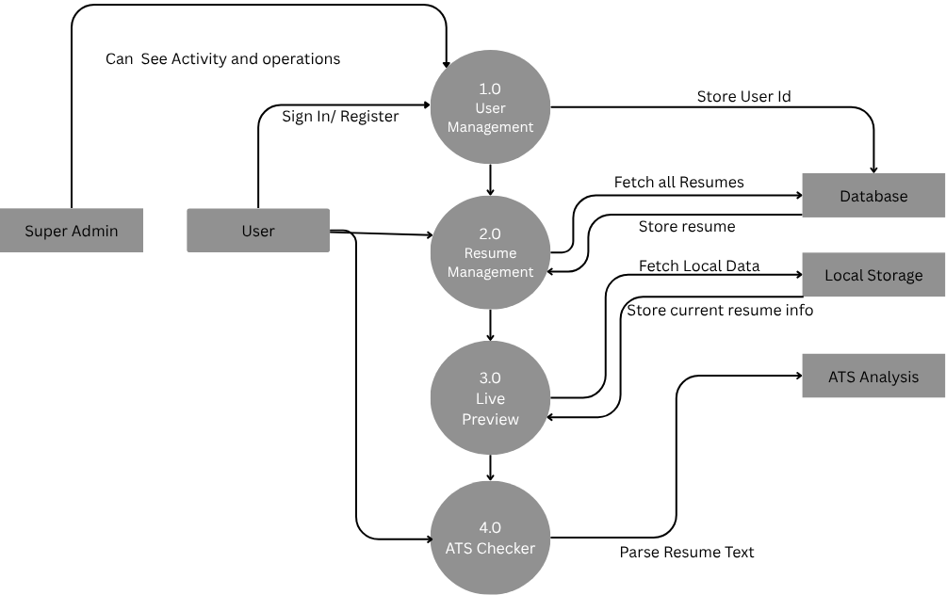
DATA FLOW DIAGRAM Level -0
Figure 5.2 DFD Level 0

Slide 12
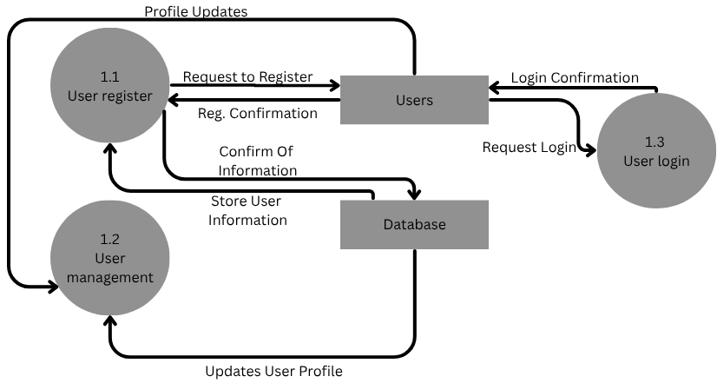
DATA FLOW DIAGRAM Level -1
Figure 5.3 DFD level 1

Slide 13
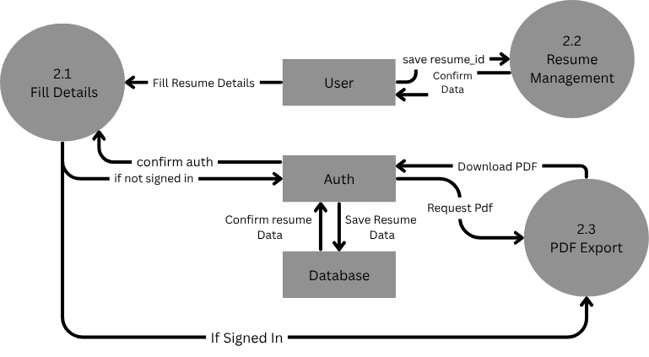
DATA FLOW DIAGRAM Level -1
Figure 5.4 DFD Level 1

Slide 14
CONCLUSION
Working on the Resume Builder project has been a great learning experience. It allowed me to apply my technical skills to solve a real problem that many students face creating a strong & professional resume. Through this project I explored modern web technologies built a user-friendly platform and added useful features like an ATS checker to improve resume quality. Overall, this project not only helped me grow as a developer but also gave me the chance to build something meaningful that can actually help students in their job search journey.

Slide 15
FUTURE SCOPE
LinkedIn Integration
Multi-Language Support
More Resume Templates
Admin Panel With Analytics
Enhaced Mobile UX

Slide 16
Thank You

